Slide 1
AWS Machine Learning
Data Collection

Slide 2
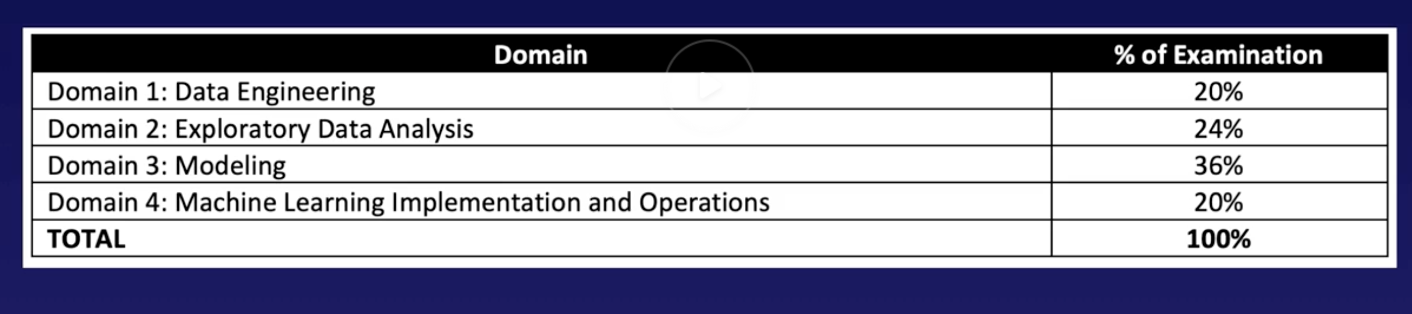
Exam breakdown

Slide 3
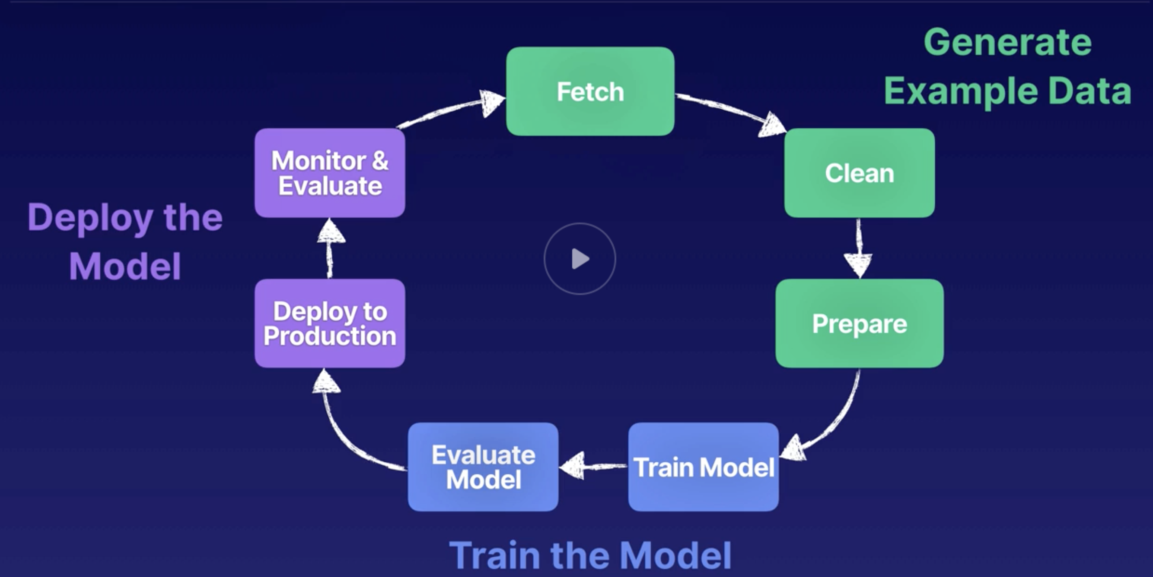
ML Cycle

Slide 4
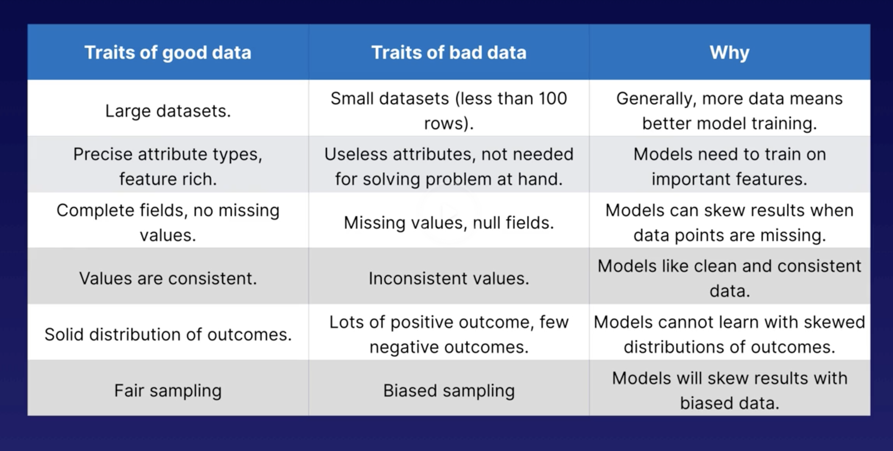
Good data traits

Slide 5
Rule of thumb
10 times as many data sets as features
Need to build a single data repo

Slide 6
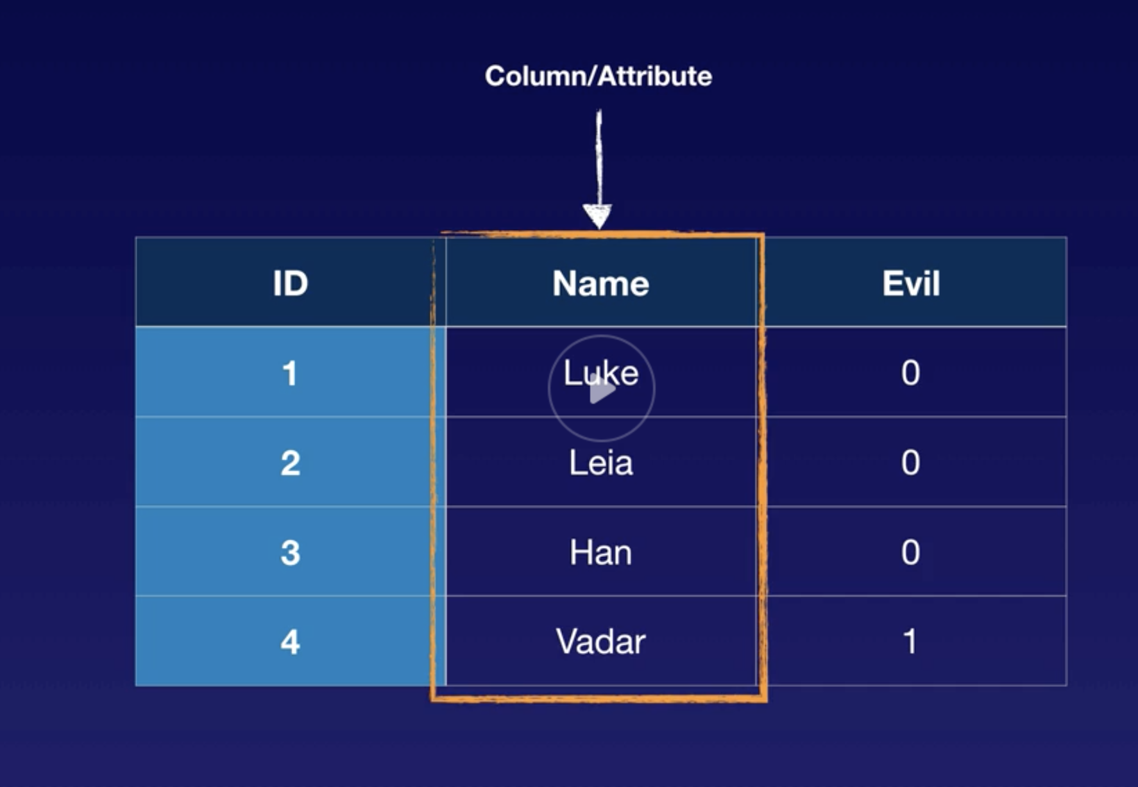
Data
Dataset – input/training data
Column/attrib/feature
Rows/observation/sample/data points
Structured data – Schema
Unstructured data – no schema
Semi structured – NoSQL, JSON, CSV

Slide 7
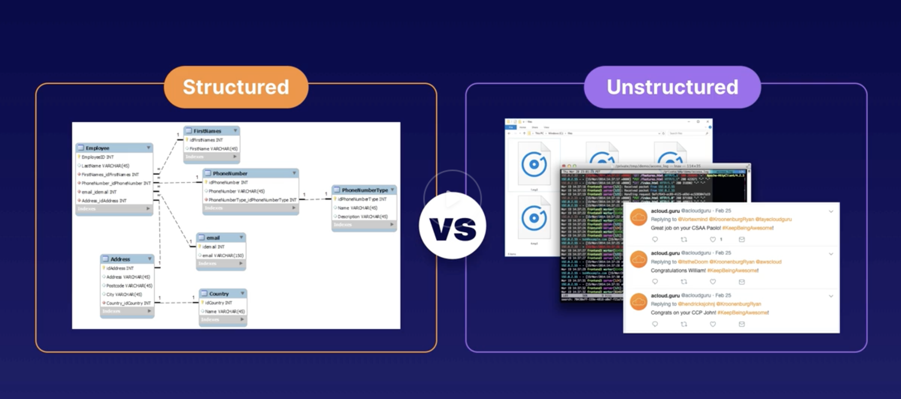
Types of Data

Slide 8
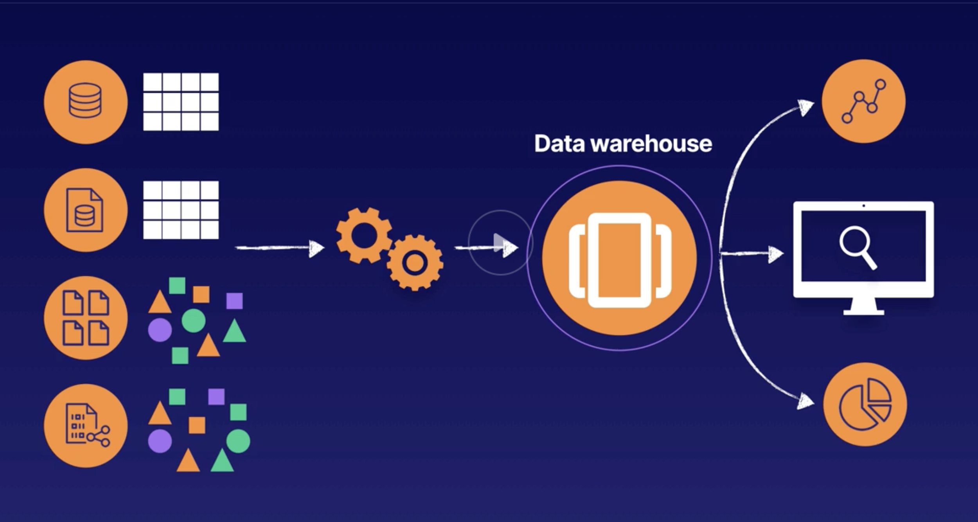
Datawarehouse

Slide 9
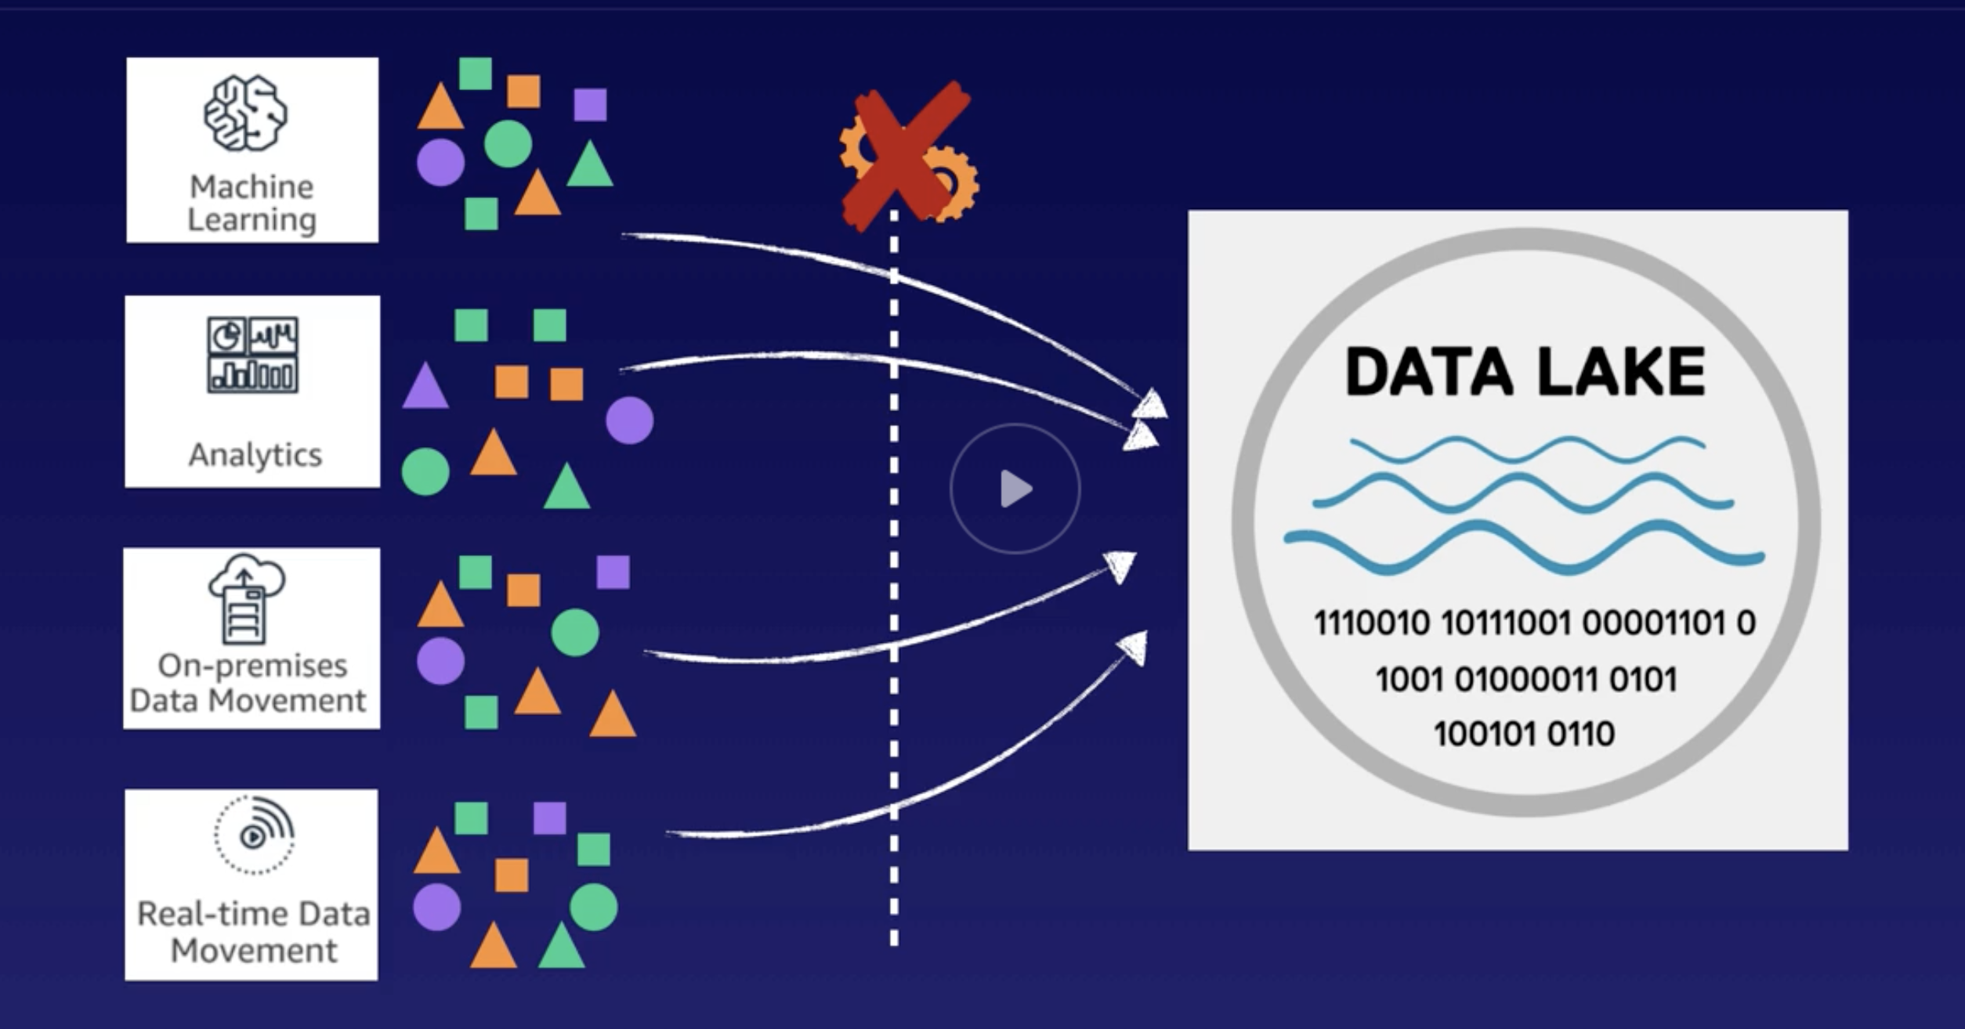
Data lake

Slide 10
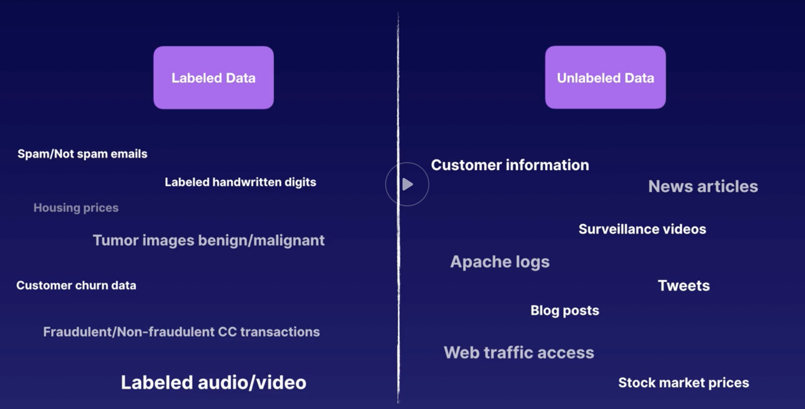
Data
Labeled data – with target attribute
Unlabeled data – without target attribute/feature

Slide 11
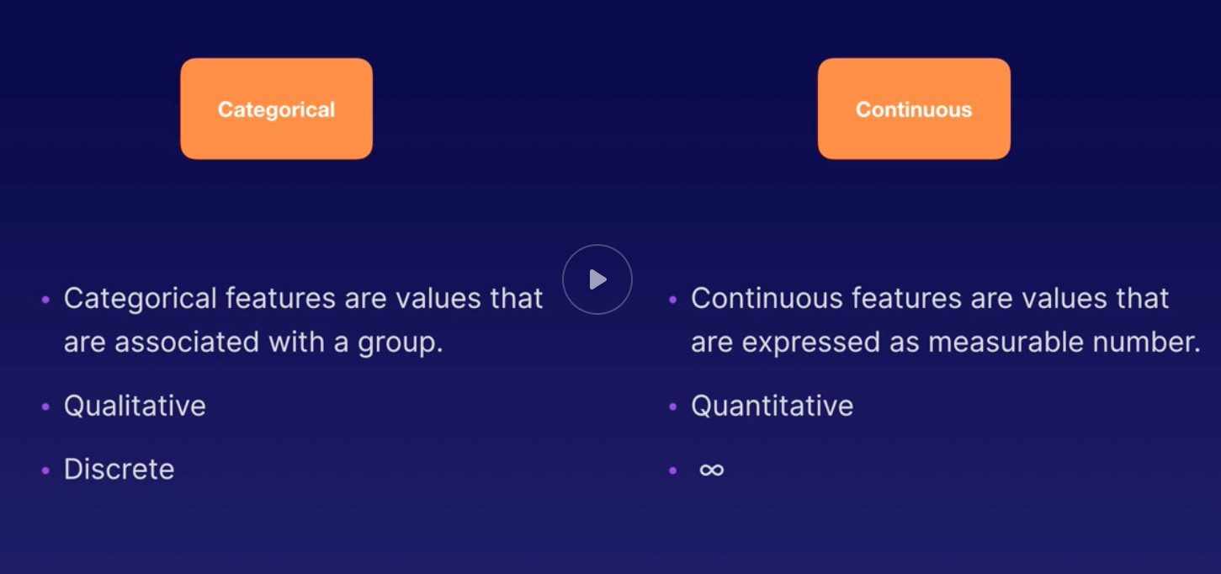
Categorical / Continuous features

Slide 12
Features
Categorical – can be grouped
Continuous – data set can be added in number line

Slide 13
Text data (corpus data)
Datasets collected from text
NLP
Speech recognition
Text to speech

Slide 14
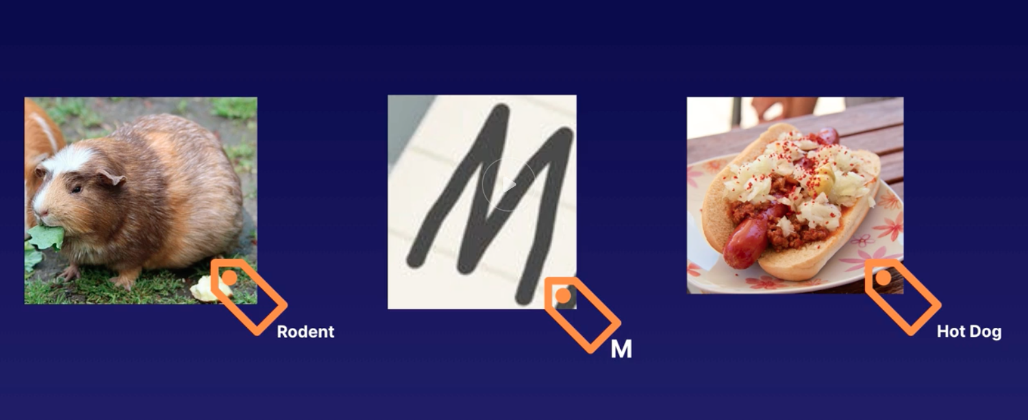
More data types
Ground truth Data
Data that has successfully labeled as trusted data
Sagemaker ground truth – helps build ground truth datasets with tagging and labeling
Image Data
Datasets with tagged images

Slide 15
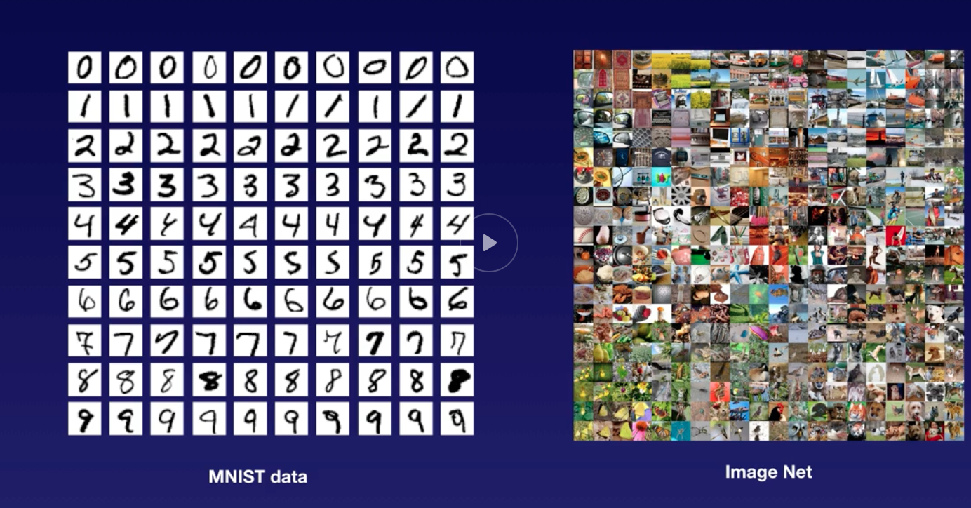
Image data

Slide 16
Time series data
Stock market data
Web traffic
Log files

Slide 17
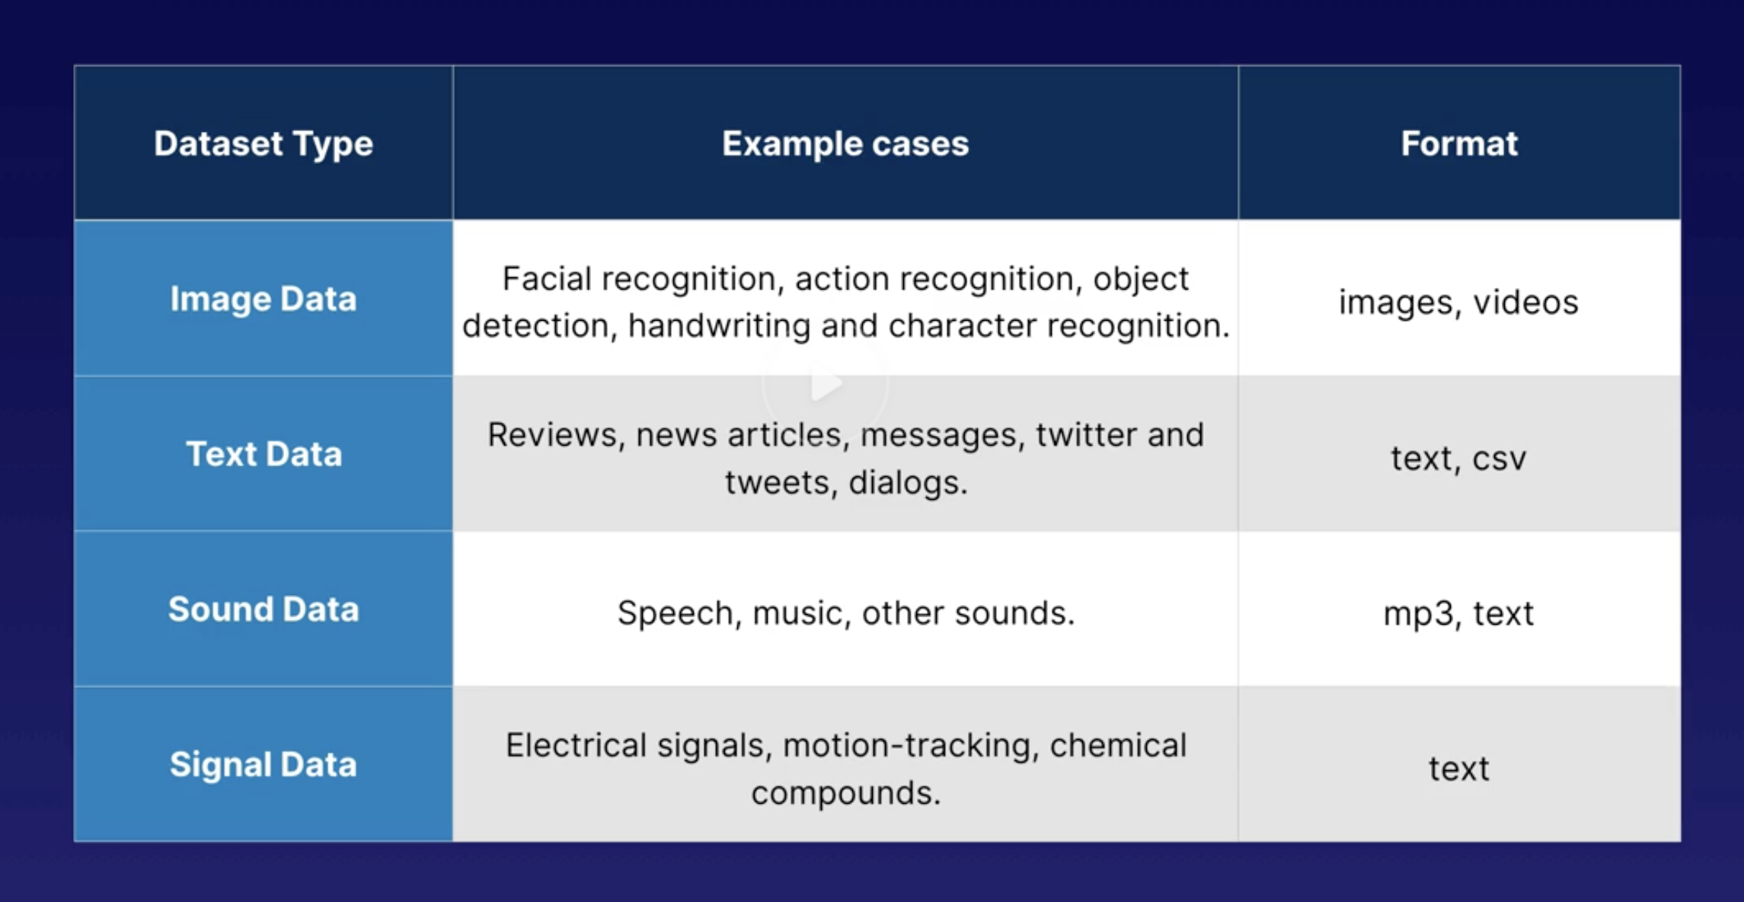
Data types

Slide 18
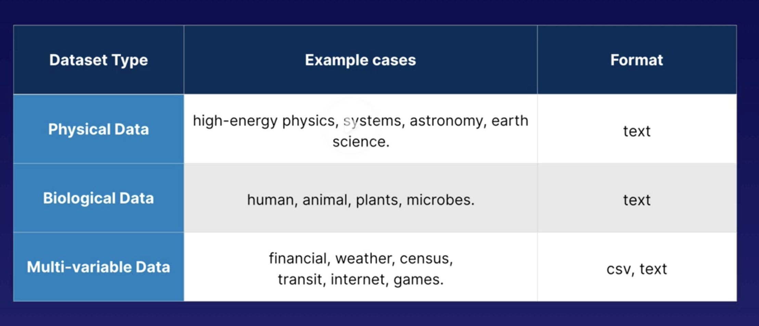
Data types

Slide 19
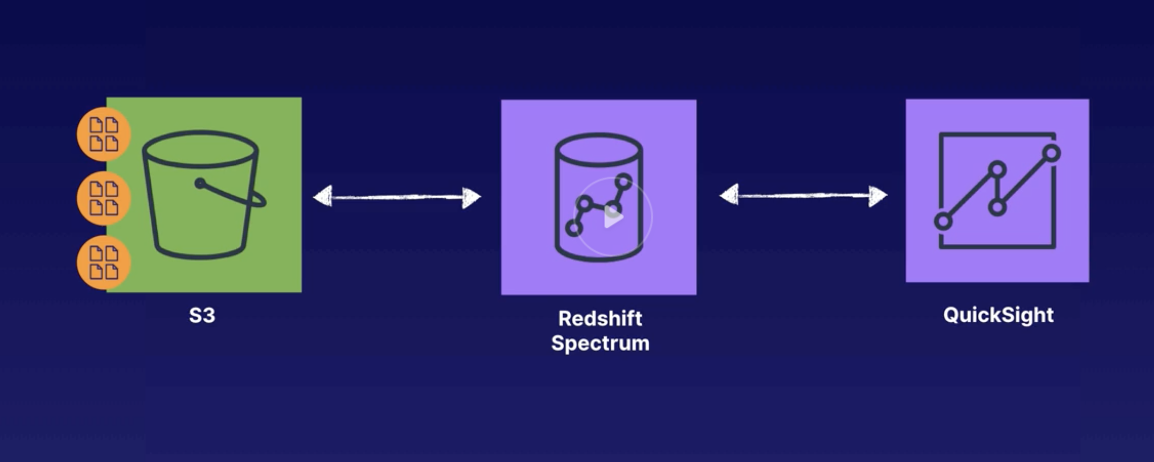
AWS Datastores
S3 used mainly for ML dataset storage
RDS can be used or relational DB - for structured data
DynamoDB is best of noSQL data, unstructured, semi structured in JSON format
Redshift petabyte scale datawarehouse

Slide 20
AWS Datastores
Timestream – has time series data – iot, server logs, stock market
DocumentDB – migrate your mongoDB data, better scalability than mongoDB

Slide 21
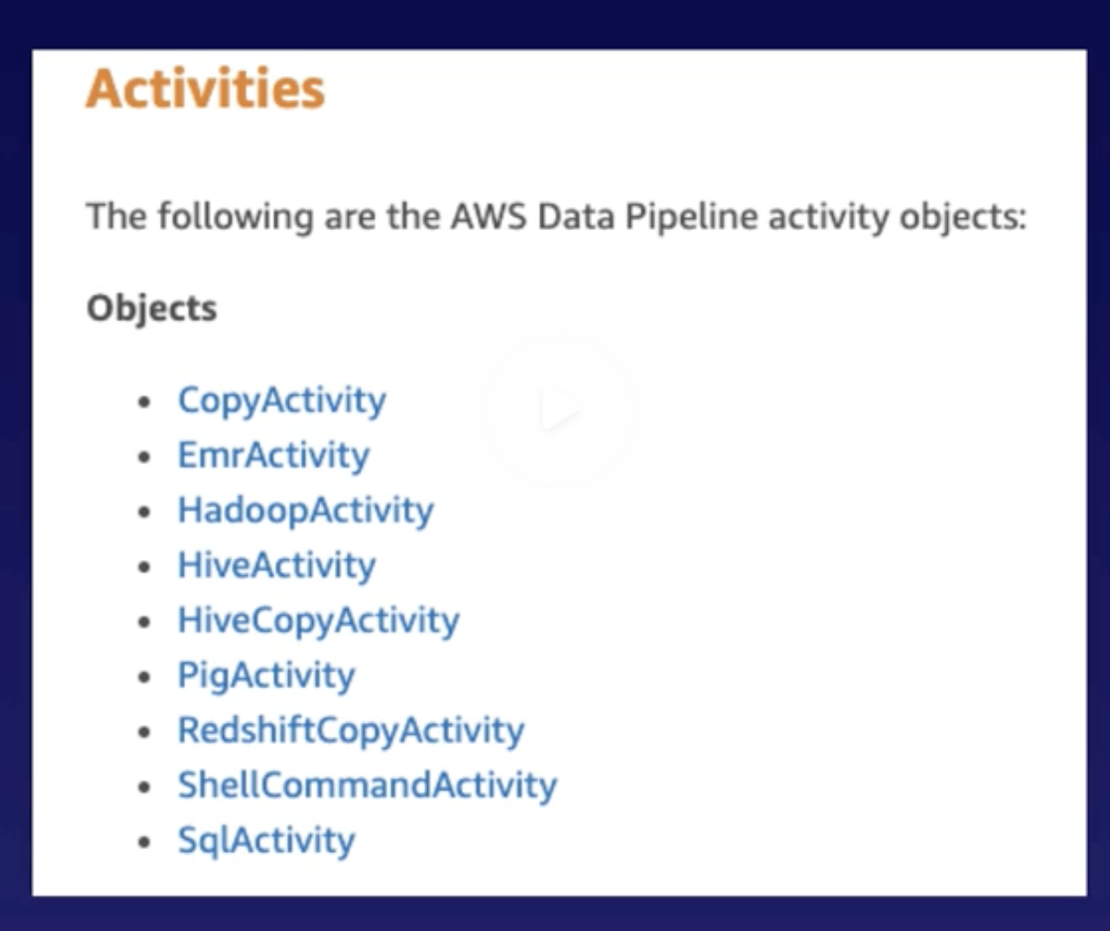
Data Migration tools
Data Pipeline
Can manage retry
Logic
Has custom pipelines

Slide 22
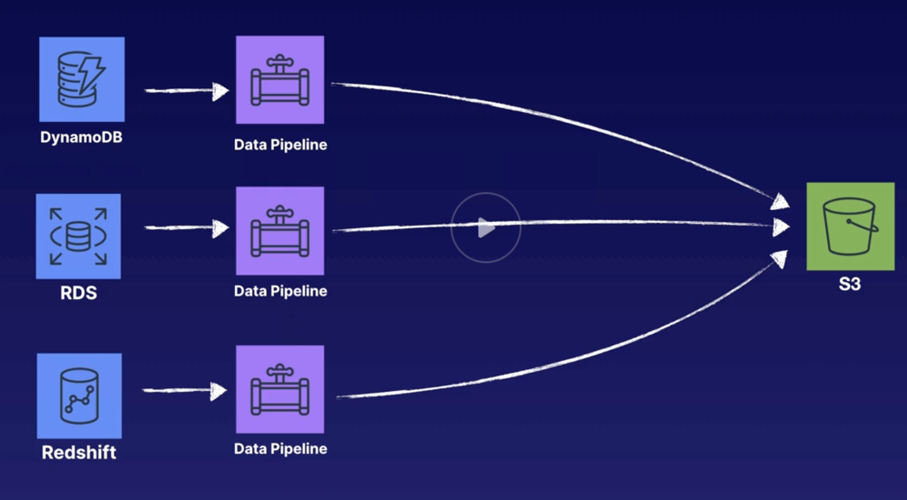

Slide 23
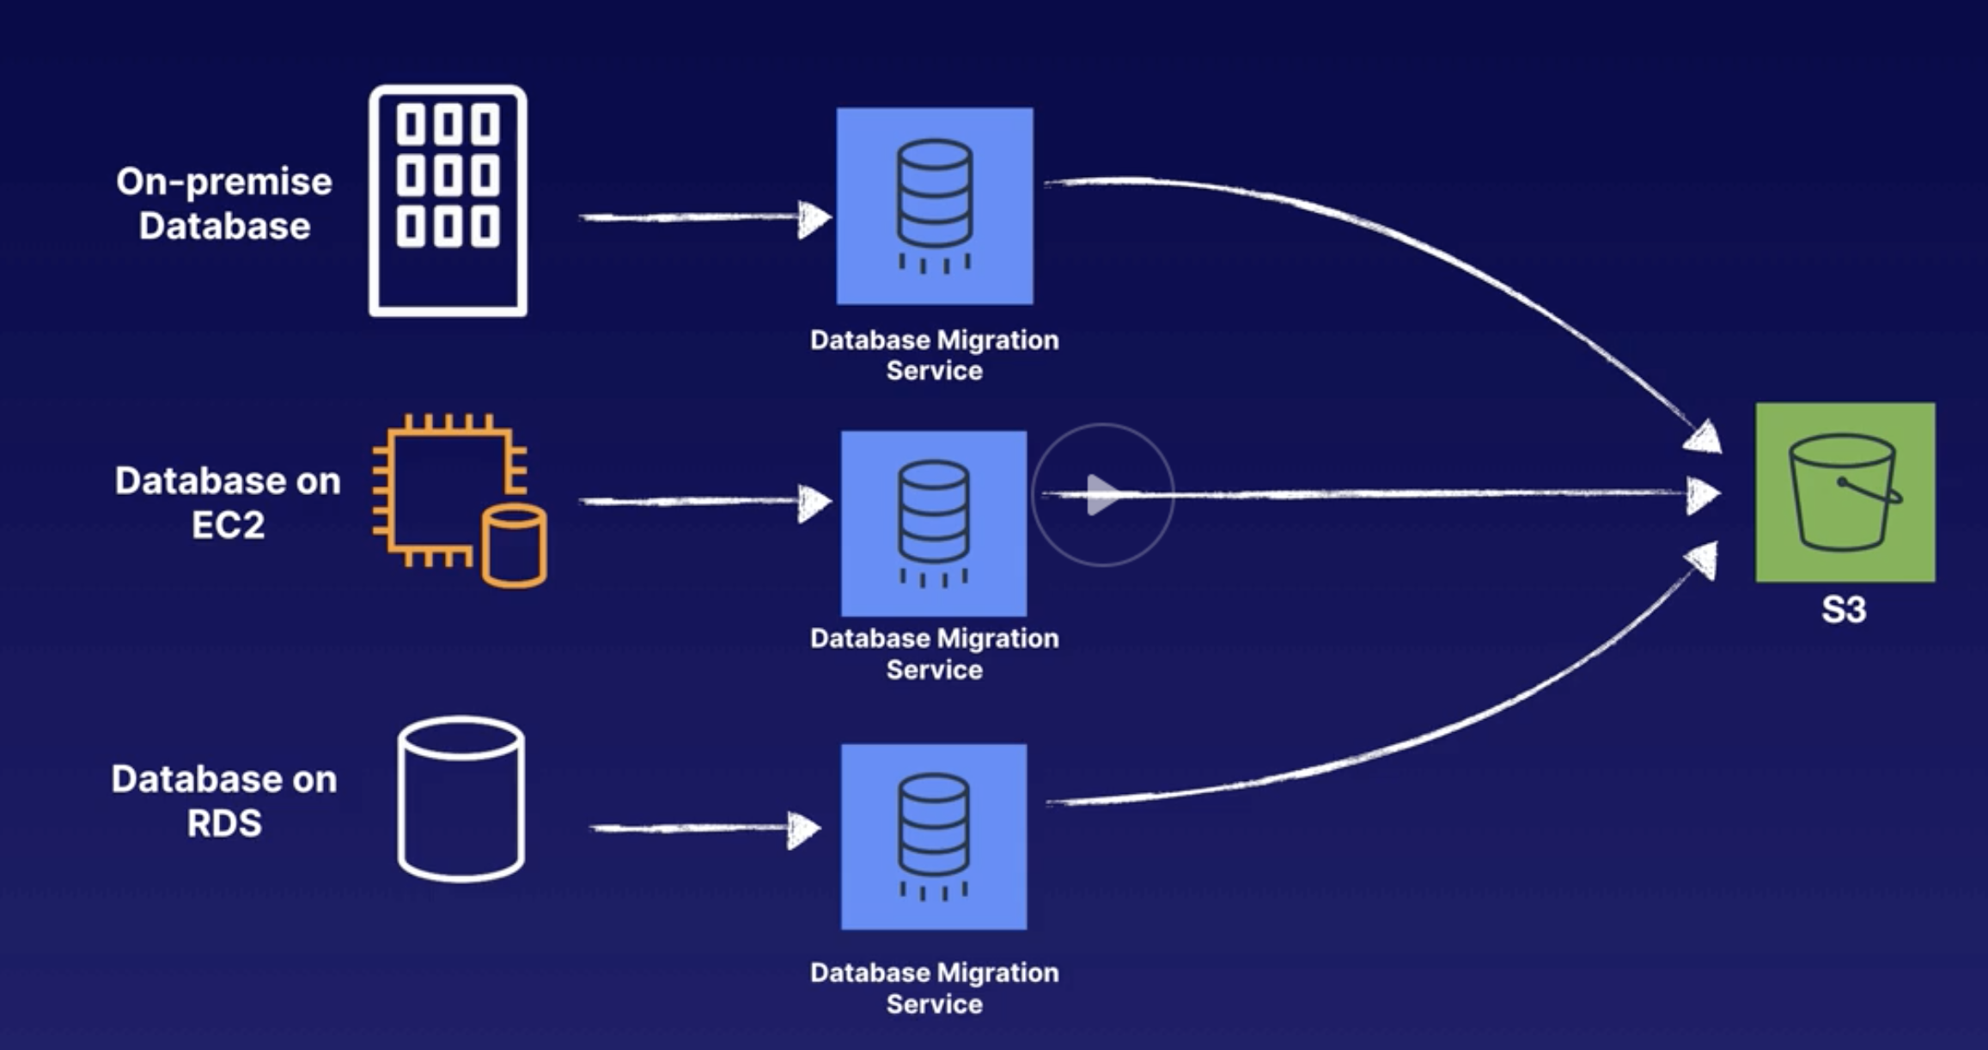
DMS
Database migration service
Xfer between to RDS – homogenious migration
SQL server – s3 – heterogenious
DMS handles underlying
Resources unlike Datapipeline

Slide 24
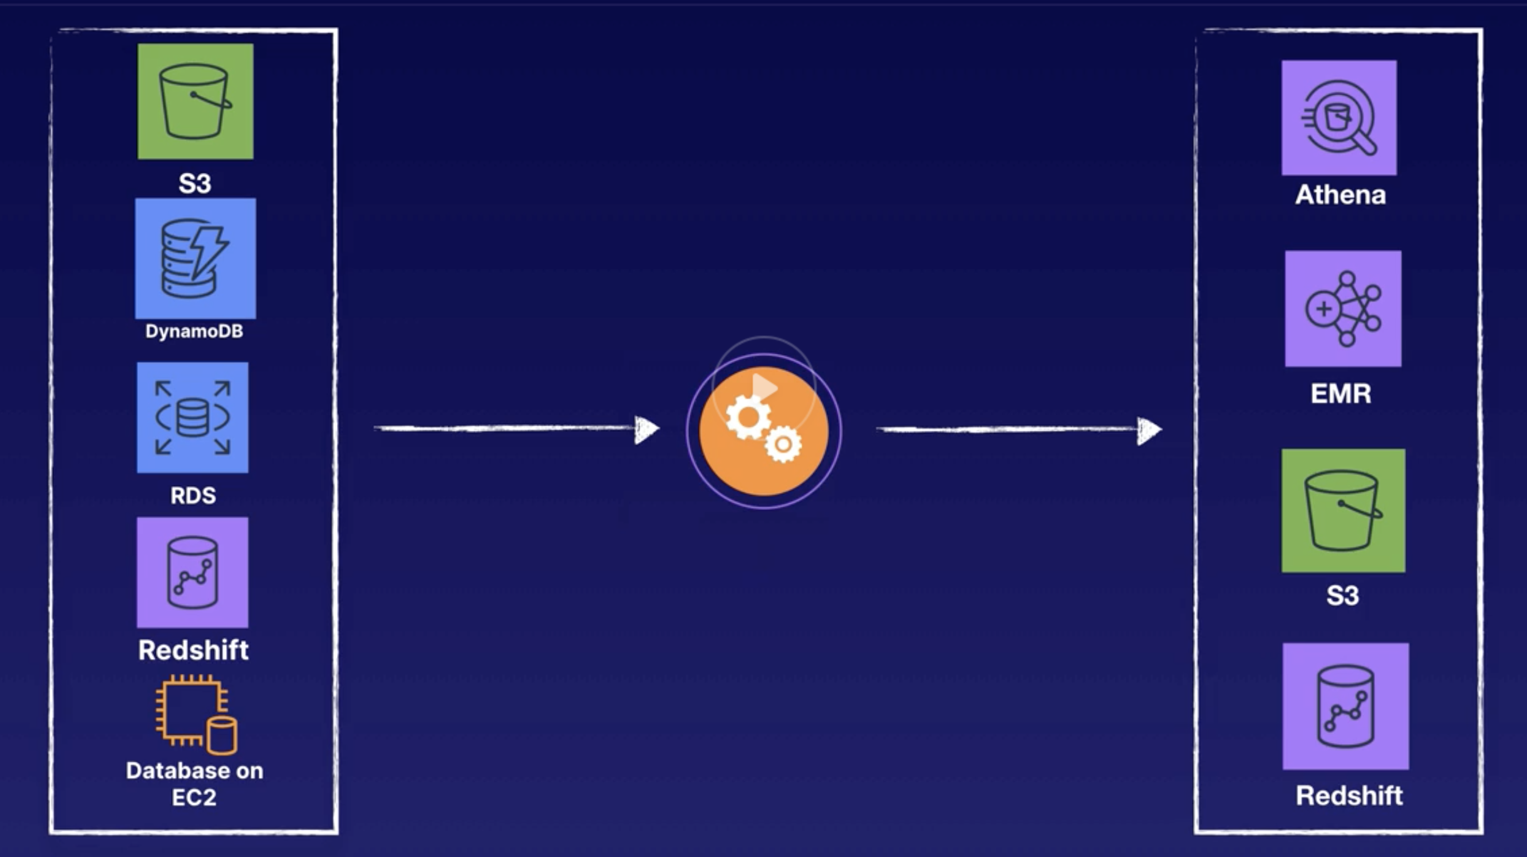
AWS Glue
Read data from sources and setup classifiers to find some sort of pattern, and move to Athena, EMR, S3, Redshift

Slide 25
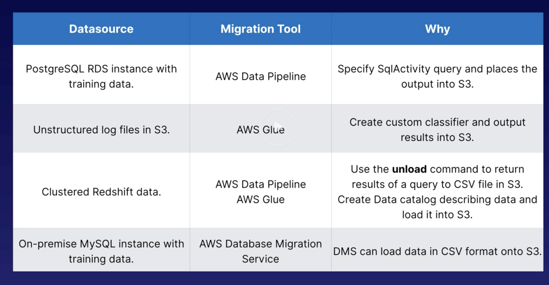

Slide 26
EMR – store petabytes of data in distributed file systems
Athena – serverless platform lets run query S3 data
Redshift spectrum – must have redshift cluster

